Slide 1
NoSQL

Slide 2
Outline for today
Introduction to NoSQL
Architecture
Sharding
Replica sets
NoSQL Assumptions and the CAP Theorem
Strengths and weaknesses of NoSQL
Cassandra DB
Functionality
Examples
2

Slide 3
Why this topic?
Client’s Application Roadmap
“Reduction of cycle time for the document intake process. Currently, it can take anywhere from a few days to a few weeks from the time the documents are received to when they are available to the client.”
New York Times used Hadoop/MapReduce to convert pre-1980 articles that were TIFF images to PDF.
Notes:
-> Read an article how the NYT used Hadoop/MapReduce, Amazon S3, and Amazon EC2 to convert 4TB of TIFF images into PDFs (http://open.blogs.nytimes.com/tag/mapreduce)
-> Had just read a client’s Application Roadmap where one of the listed benefits was to reduce the document intake process.
-> These two processes may be completely different and not applicable but it would be nice to have enough knowledge to know that Hadoop/MapReduce would not work in this situation or know enough to say ‘Eureka!’

Slide 4








Taxonomy of NoSQL
Key-value
Graph database
Document-oriented
Column family
3

Slide 5
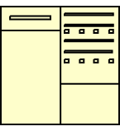
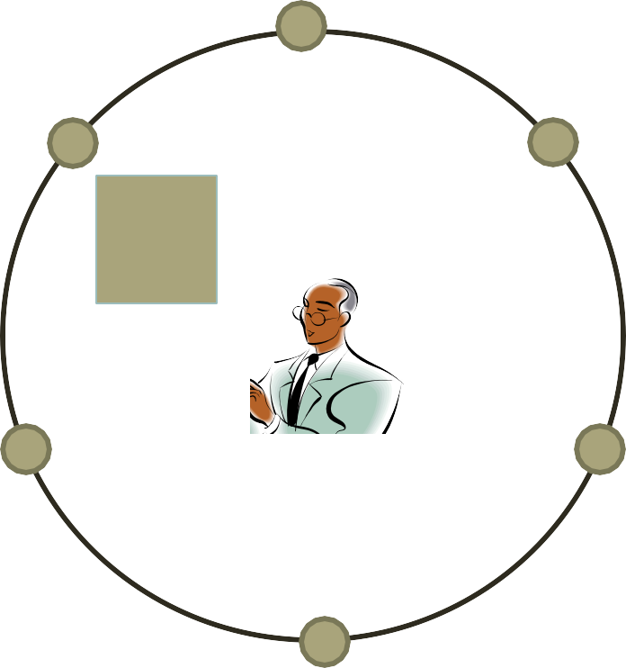
Typical NoSQL architecture
Hashing function maps each key to a server (node)
K
4

Slide 6
Why Cloud Data Stores
Explosion of social media sites (Facebook, Twitter) with large data needs
Explosion of storage needs in large web sites such as Google, Yahoo
Much of the data is not files
Rise of cloud-based solutions such as Amazon S3 (simple storage solution)
Shift to dynamically-typed data with frequent schema changes

Slide 7
History of the World, Part 1
Relational Databases – mainstay of business
Web-based applications caused spikes
Especially true for public-facing e-Commerce sites
Developers begin to front RDBMS with memcache or integrate other caching mechanisms within the application (ie. Ehcache)
Notes:
-> For the longest time (and still true today), the big relational database vendors such as Oracle, IBM, Sybase, and a lesser extent Microsoft were the mainstay of how data was stored.
-> During the Internet boom, startups looking for low-cost RDBMS alternatives turned to MySQL and PostgreSQL.
-> The ‘Slashdot Effect’ occurs when a popular website links to a smaller site, causing a massive increase in traffic.
-> Hooking your RDBMS to a web-based application was a recipe for headaches, they are OLTP in nature. Could have hundreds of thousands of visitors in a short-time span.
-> To mitigate, began to front the RDBMS with a read-only cache such as memcache to offload a considerable amount of the read traffic.
-> As datasets grew, the simple memcache/MySQL model (for lower-cost startups) started to become problematic.

Slide 8
Scaling Up
Issues with scaling up when the dataset is just too big
RDBMS were not designed to be distributed
Began to look at multi-node database solutions
Known as ‘scaling out’ or ‘horizontal scaling’
Different approaches include:
Master-slave
Sharding
Notes:
-> Best way to provide ACID and a rich query model is to have the dataset on a single machine.
-> However, there are limits to scaling up (Vertical Scaling).
-> Past a certain point, an organization will find it is cheaper and more feasible to scale out (horizontal scaling) by adding smaller, more inexpensive (relatively) servers rather than investing in a single larger server.
-> A number of different approaches to scaling out (Horizontal Scaling).
-> DBAs began to look at master-slave and sharding as a strategy to overcome some of these issues.

Slide 9
Parallel Databases and Data Stores
Web-based applications have huge demands on data storage volume and transaction rate
Scalability of application servers is easy, but what about the database?
Approach 1: memcache or other caching mechanisms to reduce database access
Limited in scalability
Approach 2: Use existing parallel databases
Expensive, and most parallel databases were designed for decision support not OLTP
Approach 3: Build parallel stores with databases underneath

Slide 10
Scaling RDBMS – Master/Slave
Master-Slave
All writes are written to the master. All reads performed against the replicated slave databases
Critical reads may be incorrect as writes may not have been propagated down
Large data sets can pose problems as master needs to duplicate data to slaves

Slide 11
Scaling RDBMS - Sharding
Partition or sharding
Scales well for both reads and writes
Not transparent, application needs to be partition-aware
Can no longer have relationships/joins across partitions
Loss of referential integrity across shards
Notes:
-> Different sharding approaches:
-> Vertical Partitioning: Have tables related to a specific feature sit on their own server. May have to rebalance or reshard if tables outgrow server.
-> Range-Based Partitioning: When single table cannot sit on a server, split table onto multiple servers. Split table based on some critical value range.
-> Key or Hash-Based partitioning: Use a key value in a hash and use the resulting value as entry into multiple servers.
-> Directory-Based Partitioning: Have a lookup service that has knowledge of the partitioning scheme . This allows for the adding of servers or
changing the partition scheme without changing the application.
-> http://adam.heroku.com/past/2009/7/6/sql_databases_dont_scale

Slide 12
Parallel Key-Value Data Stores
Distributed key-value data storage systems allow key-value pairs to be stored (and retrieved on key) in a massively parallel system
E.g. Google BigTable, Yahoo! Sherpa/PNUTS, Amazon Dynamo, ..
Partitioning, high availability etc completely transparent to application
Sharding systems and key-value stores don’t support many relational features
No join operations (except within partition)
No referential integrity constraints across partitions
etc.

Slide 13
What is NoSQL?
Stands for No-SQL or Not Only SQL??
Class of non-relational data storage systems
E.g. BigTable, Dynamo, PNUTS/Sherpa, ..
Usually do not require a fixed table schema nor do they use the concept of joins
Distributed data storage systems
All NoSQL offerings relax one or more of the ACID properties (will talk about the CAP theorem)

Slide 14
NoSQL
Class of Database Management Systems
“Not only SQL”
○ Does not use SQL as querying language
○ Distributed, fault-tolerant architecture
○ No fixed schema (formally described structure)
○ No joins (typical in databases operated with SQL)
■ Expensive operation for combining records from two or more tables into one set
■ Joins require strong consistency and fixed schemas
● Lack of these makes NoSQL databases more flexible
It's not a replacement for a RDBMS but compliments it
Source: http://www.cs.tut.fi/~tjm/seminars/nosql2012/NoSQL-Intro.pdf

Slide 15
Typical NoSQL API
Basic API access:
get(key) -- Extract the value given a key
put(key, value) -- Create or update the value given its key
delete(key) -- Remove the key and its associated value
execute(key, operation, parameters) -- Invoke an operation to the value (given its key) which is a special data structure (e.g. List, Set, Map .... etc).
Notes:
-> http://horicky.blogspot.com/2009/11/nosql-patterns.html

Slide 16
Flexible Data Model
ColumnFamily: Rockets
Key
Value
1
Name
Value
name
Rocket-Powered Roller Skates
toon
Ready, Set, Zoom
inventoryQty
5
brakes
false
2
Name
Value
name
Little Giant Do-It-Yourself Rocket-Sled Kit
toon
Beep Prepared
inventoryQty
4
brakes
false
3
Name
Value
name
Acme Jet Propelled Unicycle
toon
Hot Rod and Reel
inventoryQty
1
wheels
1

Slide 17
NoSQL Data Storage: Classification
Uninterpreted key/value or ‘the big hash table’.
Amazon S3 (Dynamo)
Flexible schema
BigTable, Cassandra, HBase (ordered keys, semi-structured data),
Sherpa/PNuts (unordered keys, JSON)
MongoDB (based on JSON)
CouchDB (name/value in text)
Notes:
.

Slide 18
Characteristics of NoSQL Databases

Slide 19
1. Distributed Computing
Scalability
Vertical Scaling (scale up)
Horizontal Scaling (scale out)
Much easier linear approach to database scaling
Reliability,
Sharing of Resources,
Performance
http://www.3pillarglobal.com/insights/just-say-yes-to-nosql

Slide 20
2. Data Model
Key Value Stores
Document Stores
Column Based Stores
Graph Databases
XML Databases

Slide 21
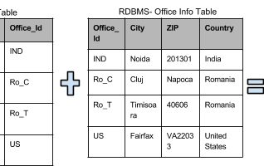
RDBMS vs. Doc Store

Slide 22
3. Transactions (weak)
No full transactional guarantee
No guarantee of simultaneous completion of transactions at all nodes
Asynchronous inserts & updates
Guarantees availability of data
Social media applications
Simultaneous transactions not strictly needed.

Slide 23
Partitioning
Very large systems will partition at some point
➔Choose one of consistency or availablity
Traditional database choose consistency
Most Web applications choose availability
Except for specific parts such as order processing

Slide 24
4. BASE (vs. ACID)
BASE
Basically available
Appears to work most of the time
Softstate
Stores don’t have to be write-consistent
Different replicas don’t have to be mutually consistent
Eventual consistency
Stores exhibit consistency at some later point (e.g., lazily at read time)
https://neo4j.com/blog/acid-vs-base-consistency-models-explained/

Slide 25
Characteristics of BASE Datastores
Less strict than ACID
Synchronization amongst data is not feasible
Exact values not necessary
Challenge: How to do updates?
Values availability
Important for scalability

Slide 26
Data Consistency
Data will be consistent in the future, either at readtime (e.g., Riak)
It will be consistent, but only for certain processed past snapshots (e.g., Datomic)
BASE consistency model is primarily used by aggregate stores, including column family, key-value, and document stores

Slide 27
Eventual Consistency
When no updates occur for a long period of time, eventually all updates will propagate through the system and all the nodes will be consistent
For a given accepted update and a given node, eventually either the update reaches the node or the node is removed from service
Known as BASE (Basically Available, Soft state, Eventual consistency), as opposed to ACID
Soft state: copies of a data item may be inconsistent
Eventually Consistent – copies becomes consistent at some later time if there are no more updates to that data item

Slide 28
Theory of NOSQL: CAP
GIVEN:
Many nodes
Nodes contain replicas of partitions
of the data
Consistency
All replicas contain the same version of data
Client always has the same view of the data (no matter what node)
Availability
System remains operational on failing nodes
All clients can always read and write
Partition tolerance
multiple entry points
System remains operational on system split (communication malfunction)
System works well across physical
network partitions
C
A P
CAP Theorem: satisfying all three at the same time is impossible
6

Slide 29
CAP Theorem 1/2
It is impossible for a distributed computer system to simultaneously provide all three of the following guarantees:
Consistency (all nodes see the same data at the same time)
Availability (a guarantee that every request receives a response about whether it was successful or failed)
Partition tolerance (the system continues to operate despite arbitrary message loss or failure of part of the system)
A distributed system can satisfy any two of these guarantees at the same time, but not all three.
Gilbert and Lynch, Brewer's conjecture and the feasibility of consistent, available, partition-tolerant web services, 2002

Slide 30
CAP Theorem 2/2
● In other words, CAP can be expressed as "If the network is broken, your database won’t work"
○ "won't work" = down OR inconsistent
● In RDBMS we do not have P (network partitions)
○ Consistency and Availability are achieved
● In NoSQL we want to have P
○ Need to select either C or A
○ Drop A -> Accept waiting until data is consistent
○ Drop C -> Accept getting inconsistent data sometimes

Slide 31
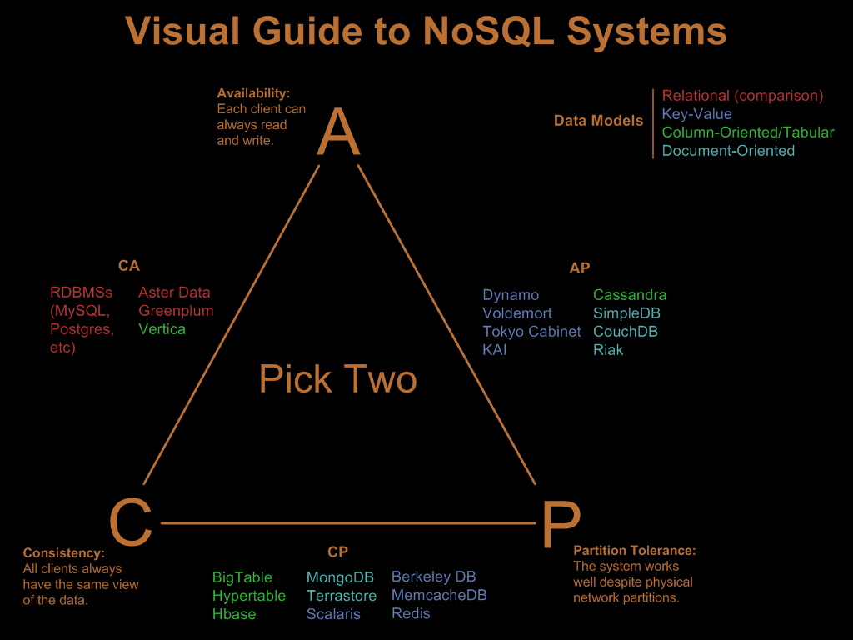
http://blog.nahurst.com/visual-guide-to-nosql-systems

Slide 32
Availability
Traditionally, thought of as the server/process available five 9’s (99.999 %).
However, for large node system, at almost any point in time there’s a good chance that a node is either down or there is a network disruption among the nodes.
Want a system that is resilient in the face of network disruption

Slide 33

CAP theorem for NoSQL
What the CAP theorem really says:
If you cannot limit the number of faults and requests can be directed to any server and you insist on serving every request you
receive then you cannot possibly be consistent
Eric Brewer 2001
How it is interpreted:
You must always give something up: consistency, availability or tolerance to failure and reconfiguration
5

Slide 34
5. Query Language
Do not support SQL
Some other form of query language
CouchDB uses JSON to store data, JavaScript as its query language
6. No Joins

Slide 35
7. Low Cost
Cheap commodity servers
8. Easy Implementation
Schema flexibility
Less complicated relationships unlike in RDBMS

Slide 36
Sharding of data
Distributes a single logical database system across a cluster of machines
Uses range-based partitioning to distribute documents based
on a specific shard key
Automatically balances the data associated with each shard
Can be turned on and off per collection (table)
8

Slide 37

Replica Sets
replica1
Host1:10000
Redundancy and Failover
Zero downtime for upgrades and maintenance
Master-slave replication
Strong Consistency
Delayed Consistency
Geospatial features
Host2:10001
Host3:10002
Client
9

Slide 38
How does NoSQL vary from RDBMS?
Looser schema definition
Applications written to deal with specific documents/ data
Applications aware of the schema definition as opposed to the data
Designed to handle distributed, large databases
Trade offs:
No strong support for ad hoc queries but designed for speed and growth of database
Query language through the API
Relaxation of the ACID properties
10

Slide 39
Benefits of NoSQL
Elastic Scaling
RDBMS scale up – bigger load , bigger server
NO SQL scale out – distribute data across multiple hosts seamlessly
DBA Specialists
RDMS require highly trained expert to monitor DB
NoSQL require less management, automatic repair and simpler data models
Big Data
Huge increase in data RDMS: capacity and constraints of data volumes at its limits
NoSQL designed for big data
11

Slide 40
Benefits of NoSQL
Flexible data models
Change management to schema for RDMS have to be carefully managed
NoSQL databases more relaxed in structure of data
Database schema changes do not have to be managed as one complicated change unit
Application already written to address an amorphous schema
Economics
RDMS rely on expensive proprietary servers to manage data
No SQL: clusters of cheap commodity servers to manage the data and transaction volumes
Cost per gigabyte or transaction/second for NoSQL can be lower than the cost for a RDBMS
12

Slide 41
Drawbacks of NoSQL
Support
RDBMS vendors provide a high level of support to clients
Stellar reputation
NoSQL – are open source projects with startups supporting them
Reputation not yet established
Maturity
RDMS mature product: means stable and dependable
Also means old no longer cutting edge nor interesting
NoSQL are still implementing their basic feature set
13

Slide 42
Drawbacks of NoSQL
Administration
RDMS administrator well defined role
No SQL’s goal: no administrator necessary however NO SQL still requires effort to maintain
Lack of Expertise
Whole workforce of trained and seasoned RDMS developers
Still recruiting developers to the NoSQL camp
Analytics and Business
Intelligence
RDMS designed to
address this niche
NoSQL designed to meet the needs of an Web 2.0 application - not designed for ad hoc query of the data
Tools are being developed to address this need
14

Slide 43
RDB ACID to NoSQL BASE
Basically
Atomicity
Available (CP)
Consistency
Soft-state
Isolation
(State of system may change
over time)
Durability
Eventually consistent
(Asynchronous propagation)
15
Pritchett, D.: BASE: An Acid Alternative (queue.acm.org/detail.cfm?id=1394128)
Notes:
Atomicity: Multiple statements for single transaction are treated like single statement. If transactions fail then all will not be executed
Isolation for concurrent transactions
Durability – Copleted transactions are truly committed to non-volatile memory

Slide 44
What does NoSQL Not Provide?
Joins
Group by
But PNUTS provides interesting materialized view approach to joins/aggregation.
ACID transactions
SQL
Integration with applications that are based on SQL
Notes:
-> No JDBC
-> Data integrity at the application layer

Slide 45
Further Reading
Use a search engine to find information on data storage systems such as
BigTable (Google), Dynamo (Amazon), Cassandra (Facebook/Apache), Pnuts/Sherpa (Yahoo), CouchDB, MongoDB, …
Several of above are open source

Slide 46
Cassandra
Originally developed at Facebook
Follows the BigTable data model: column-oriented
Uses the Dynamo Eventual Consistency model
Written in Java
Open-sourced and exists within the Apache family
Uses Apache Thrift as its API

Slide 47
Thrift
Created at Facebook along with Cassandra
Is a cross-language, service-generation framework
Binary Protocol (like Google Protocol Buffers)
Compiles to: C++, Java, PHP, Ruby, Erlang, Perl, ...
Notes:
-> http://incubator.apache.org/thrift/static/thrift-20070401.pdf
-> http://incubator.apache.org/thrift/
-> Thrift also created by Facebook engineers and donated to Apache

Slide 48
Data Model
Within Cassandra, you will refer to data this way:
Column: smallest data element, a tuple with a name and a value
:Rockets, '1' might return:
{'name' => ‘Rocket-Powered Roller Skates',
‘toon' => ‘Ready Set Zoom',
‘inventoryQty' => ‘5‘,
‘productUrl’ => ‘rockets\1.gif’}
Notes:
-> Have heard it referred to as a 4 or 5 dimensional hash table.

Slide 49
Data Model Continued
ColumnFamily: There’s a single structure used to group both the Columns and SuperColumns. Called a ColumnFamily (think table), it has two types, Standard & Super.
Column families must be defined at startup
Key: the permanent name of the record
Keyspace: the outer-most level of organization. This is usually the name of the application. For example, ‘Acme' (think database name).
Notes:
-> Keys have different numbers of columns, so the database can scale in an irregular way.
-> Simple and Super: super columns are columns within columns.
-> Refer to date by keyspace, a column family, a key, an optional super column, and a column.

Slide 50
Searching
Relational
SELECT `column` FROM `database`,`table` WHERE `id` = key;
SELECT product_name FROM rockets WHERE id = 123;
Cassandra (standard)
keyspace.getSlice(key, “column_family”, "column")
keyspace.getSlice(123, new ColumnParent(“rockets”), getSlicePredicate());

Slide 51
Typical NoSQL API
Basic API access:
get(key) -- Extract the value given a key
put(key, value) -- Create or update the value given its key
delete(key) -- Remove the key and its associated value
execute(key, operation, parameters) -- Invoke an operation to the value (given its key) which is a special data structure (e.g. List, Set, Map .... etc).
Notes:
-> http://horicky.blogspot.com/2009/11/nosql-patterns.html

Slide 52
Cassandra and Consistency
Talked previous about eventual consistency
Cassandra has programmable read/writable consistency
One: Return from the first node that responds
Quorom: Query from all nodes and respond with the one that has latest timestamp once a majority of nodes responded
All: Query from all nodes and respond with the one that has latest timestamp once all nodes responded. An unresponsive node will fail the node
Notes:
-> http://www.slideshare.net/julesbravo/cassandra-3125809
-> Have a good simple benchmark to show to demonstrate difference between Cassandra and MySQL

Slide 53
Cassandra and Consistency
Zero: Ensure nothing. Asynchronous write done in background
Any: Ensure that the write is written to at least 1 node
One: Ensure that the write is written to at least 1 node’s commit log and memory table before receipt to client
Quorom: Ensure that the write goes to node/2 + 1
All: Ensure that writes go to all nodes. An unresponsive node would fail the write

Slide 54
Consistent Hashing
Partition using consistent hashing
Keys hash to a point on a fixed circular space
Ring is partitioned into a set of ordered slots and servers and keys hashed over these slots
Nodes take positions on the circle.
A, B, and D exists.
B responsible for AB range.
D responsible for BD range.
A responsible for DA range.
C joins.
B, D split ranges.
C gets BC from D.
Notes:
-> http://senguptas.org/Documents/cassandra_cs349c_presentation.pdf

Slide 55
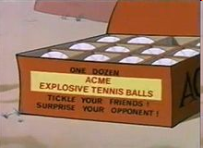


Domain Model
Design your domain model first
Create your Cassandra data store to fit your domain model
<Keyspace Name="Acme">
<ColumnFamily CompareWith="UTF8Type" Name="Rockets" />
<ColumnFamily CompareWith="UTF8Type" Name="OtherProducts" />
<ColumnFamily CompareWith="UTF8Type" Name="Explosives" />
…
</Keyspace>
Notes:
-> http://home.roadrunner.com/~tuco/looney/acme.html

Slide 56
Data Model
ColumnFamily: Rockets
Key
Value
1
Name
Value
name
Rocket-Powered Roller Skates
toon
Ready, Set, Zoom
inventoryQty
5
brakes
false
2
Name
Value
name
Little Giant Do-It-Yourself Rocket-Sled Kit
toon
Beep Prepared
inventoryQty
4
brakes
false
3
Name
Value
name
Acme Jet Propelled Unicycle
toon
Hot Rod and Reel
inventoryQty
1
wheels
1

Slide 57
Data Model Continued
Optional super column: a named list. A super column contains standard columns, stored in recent order
Say the OtherProducts has inventory in categories. Querying (:OtherProducts, '174927') might return:
{‘OtherProducts' => {'name' => ‘Acme Instant Girl', ..}, ‘foods': {...}, ‘martian': {...}, ‘animals': {...}}
In the example, foods, martian, and animals are all super column names. They are defined on the fly, and there can be any number of them per row. :OtherProducts would be the name of the super column family.
Columns and SuperColumns are both tuples with a name & value. The key difference is that a standard Column’s value is a “string” and in a SuperColumn the value is a Map of Columns.

Slide 58
Data Model Continued
Columns are always sorted by their name. Sorting supports:
BytesType
UTF8Type
LexicalUUIDType
TimeUUIDType
AsciiType
LongType
Each of these options treats the Columns' name as a different data type

Slide 59
Hector
Leading Java API for Cassandra
Sits on top of Thrift
Adds following capabilities
Load balancing
JMX monitoring
Connection-pooling
Failover
JNDI integration with application servers
Additional methods on top of the standard get, update, delete methods.
Under discussion
hooks into Spring declarative transactions
Notes:
-> Open-source at GitHub
-> Lead developer is Ran Tavoy

Slide 60
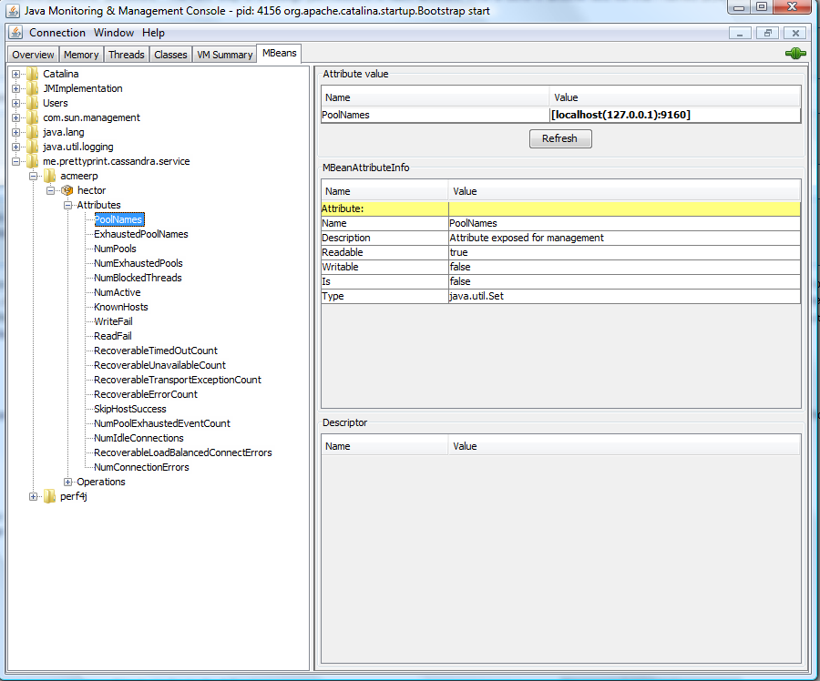
Hector and JMX
Notes:
-> Using JConsole

Slide 61
Code Examples: Tomcat Configuration
Tomcat context.xml
<Resource name="cassandra/CassandraClientFactory"
auth="Container"
type="me.prettyprint.cassandra.service.CassandraHostConfigurator"
factory="org.apache.naming.factory.BeanFactory"
hosts="localhost:9160"
maxActive="150"
maxIdle="75" />
J2EE web.xml
<resource-env-ref>
<description>Object factory for Cassandra clients.</description>
<resource-env-ref-name>cassandra/CassandraClientFactory</resource-env-ref-name>
<resource-env-ref-type>org.apache.naming.factory.BeanFactory</resource-env-ref-type>
</resource-env-ref>

Slide 62
Code Examples: Spring Configuration
Spring applicationContext.xml
<bean id="cassandraHostConfigurator“
class="org.springframework.jndi.JndiObjectFactoryBean">
<property name="jndiName">
<value>cassandra/CassandraClientFactory</value></property>
<property name="resourceRef"><value>true</value></property>
</bean>
<bean id="inventoryDao“
class="com.acme.erp.inventory.dao.InventoryDaoImpl">
<property name="cassandraHostConfigurator“
ref="cassandraHostConfigurator" />
<property name="keyspace" value="Acme" />
</bean>

Slide 63
Code Examples: Cassandra Get Operation
try {
cassandraClient = cassandraClientPool.borrowClient();
// keyspace is Acme
Keyspace keyspace = cassandraClient.getKeyspace(getKeyspace());
// inventoryType is Rockets
List<Column> result = keyspace.getSlice(Long.toString(inventoryId), new ColumnParent(inventoryType), getSlicePredicate());
inventoryItem.setInventoryItemId(inventoryId);
inventoryItem.setInventoryType(inventoryType);
loadInventory(inventoryItem, result);
} catch (Exception exception) {
logger.error("An Exception occurred retrieving an inventory item", exception);
} finally {
try {
cassandraClientPool.releaseClient(cassandraClient);
} catch (Exception exception) {
logger.warn("An Exception occurred returning a Cassandra client to the pool", exception);
}
}
Notes:
-> The purpose of these two slides is not to teach how to do Cassandra/Hector programming but to show how much programming needs to be done versus Hibernate
-> Back in the good old days of JDBC programming

Slide 64
Code Examples: Cassandra Update Operation
try {
cassandraClient = cassandraClientPool.borrowClient();
Map<String, List<ColumnOrSuperColumn>> data = new HashMap<String, List<ColumnOrSuperColumn>>();
List<ColumnOrSuperColumn> columns = new ArrayList<ColumnOrSuperColumn>();
// Create the inventoryId column.
ColumnOrSuperColumn column = new ColumnOrSuperColumn();
columns.add(column.setColumn(new Column("inventoryItemId".getBytes("utf-8"), Long.toString(inventoryItem.getInventoryItemId()).getBytes("utf-8"), timestamp)));
column = new ColumnOrSuperColumn();
columns.add(column.setColumn(new Column("inventoryType".getBytes("utf-8"), inventoryItem.getInventoryType().getBytes("utf-8"), timestamp)));
….
data.put(inventoryItem.getInventoryType(), columns);
cassandraClient.getCassandra().batch_insert(getKeyspace(), Long.toString(inventoryItem.getInventoryItemId()), data, ConsistencyLevel.ANY);
} catch (Exception exception) {
…
}

Slide 65
Some Statistics
Facebook Search
MySQL > 50 GB Data
Writes Average : ~300 ms
Reads Average : ~350 ms
Rewritten with Cassandra > 50 GB Data
Writes Average : 0.12 ms
Reads Average : 15 ms
Notes:
-> http://static.last.fm/johan/nosql-20090611/cassandra_nosql.ppt

Slide 66
Some things to think about
Ruby on Rails and Grails have ORM baked in. Would have to build your own ORM framework to work with NoSQL.
Some plugins exist.
Same would go for Java/C#, no Hibernate-like framework.
A simple JDO framework does exist.
Support for basic languages like Ruby.
Notes:
-> http://github.com/PedroGomes/datanucleus-cassandra (JDO)
-> http://github.com/wolpert/grails-cassandra

Slide 67
Some more things to think about
Troubleshooting performance problems
Concurrency on non-key accesses
Are the replicas working?
Notes:
-> Taken from: http://www.claassen.net/geek/blog/2010/02/nosql-is-new-arcadia.html

Slide 68
Don’t forget about the DBA
It does not matter if the data is deployed on a NoSQL platform instead of an RDBMS.
Still need to address:
Backups & recovery
Capacity planning
Performance monitoring
Data integration
Tuning & optimization
What happens when things don’t work as expected and nodes are out of sync or you have a data corruption occurring at 2am?
Who you gonna call?
DBA and SysAdmin need to be on board
Notes:
-> Need to educate the DBA rather than going around them.

Slide 69
Where would I use it?
For most of you, you may be working in corporate IT and a LinkedIn or Twitter is not in our future
Where would I use a NoSQL database?
Do you have somewhere a large set of uncontrolled, unstructured, data that you are trying to fit into a RDBMS?
Log Analysis
Social Networking Feeds (many firms hooked in through Facebook or Twitter)
External feeds from partners (EAI)
Data that is not easily analyzed in a RDBMS such as time-based data
Large data feeds that need to be massaged before entry into an RDBMS
Notes:
http://www.infoq.com/articles/nosql-in-the-enterprise

Slide 70
Summary
Leading users of NoSQL datastores are social networking sites such as Twitter, Facebook, LinkedIn, and Digg.
To implement a single feature in Cassandra, Digg has a dataset that is 3 terabytes and 76 billion columns.
Not every problem is a nail and not every solution is a hammer.
Notes:
NoSQL has taken a field that was "dead" (database development) and suddenly brought it back to life.

Slide 71
Questions

Slide 72
Resources
Cassandra
http://cassandra.apache.org
Hector
http://wiki.github.com/rantav/hector
http://prettyprint.me
NoSQL News websites
http://nosql.mypopescu.com
http://www.nosqldatabases.com
High Scalability
http://highscalability.com
Video
http://www.infoq.com/presentations/Project-Voldemort-at-Gilt-Groupe
Notes:
Books:
-> CouchDB (O’Reilly)
-> Hadoop (O’Reilly)
-> MongoDB (O’Reilly Forthcoming)
-> Hadoop in Action (Manning Forthcoming)
-> CouchDB in Action (Manning Forthcoming)

Slide 73
References
A number of slides adapted from:
https://www.intertech.com/resource/usergroup/NoSQL.ppt
Perry Hoekstra
https://www.cse.iitb.ac.in/infolab/Data/Courses/CS631/NoSQLDatabases.ppt
S. Sudarshan

